Slide 1
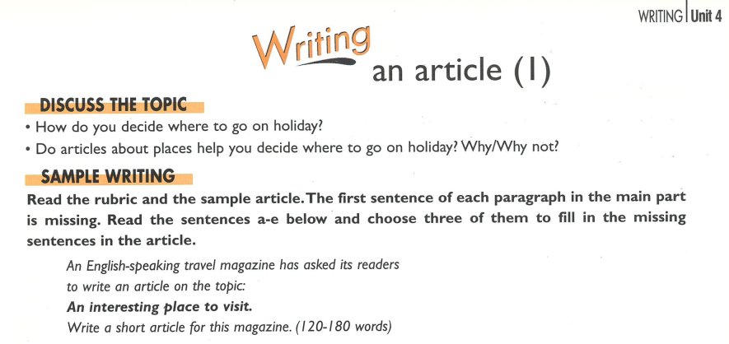

Slide 3
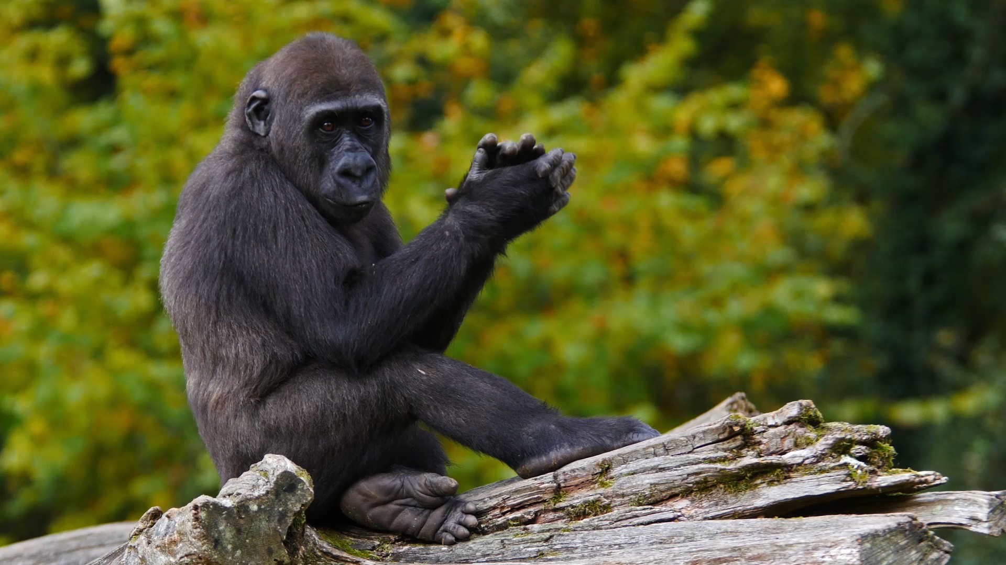

Slide 4
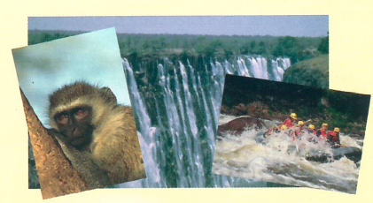
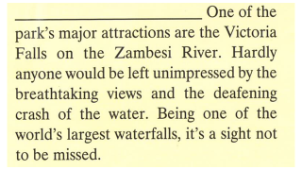
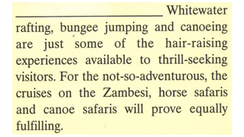
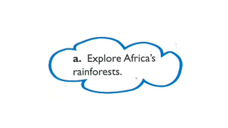
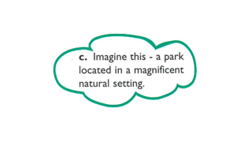
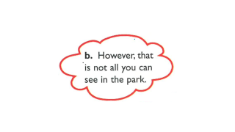
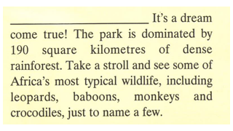
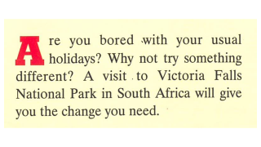
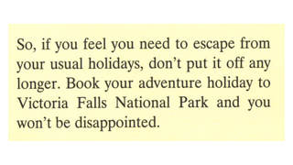

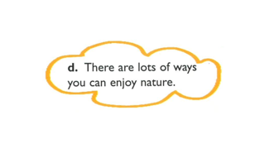

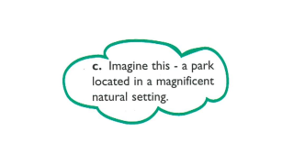
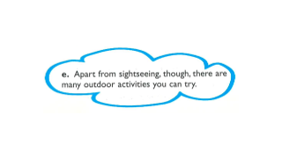

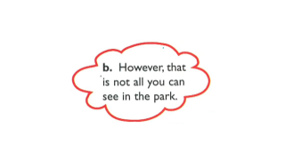



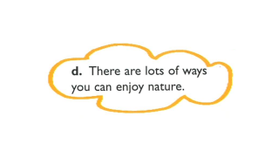
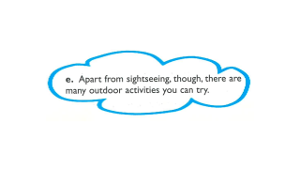
Click on the numbers for the answers.
c.
❸
e.
❶
❷
b.

Slide 5
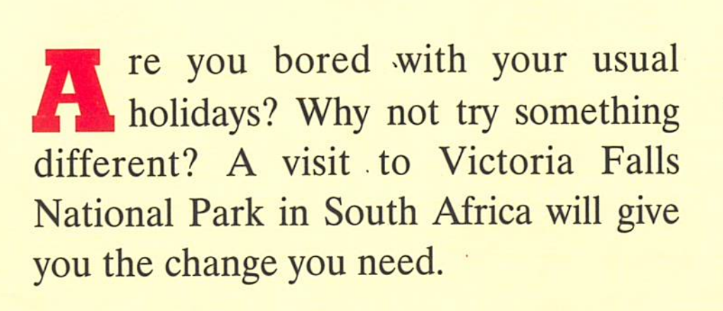

Slide 6
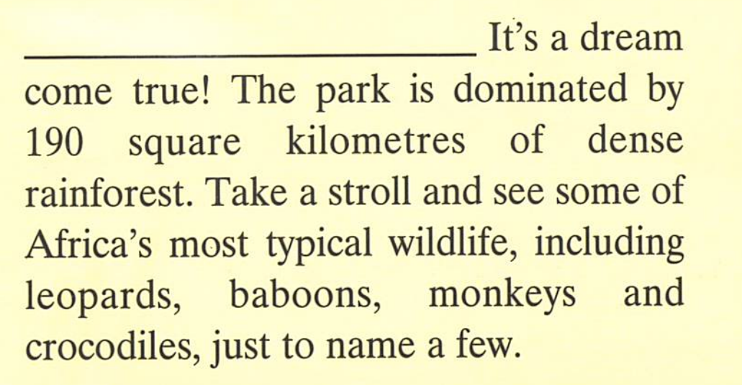

Slide 7
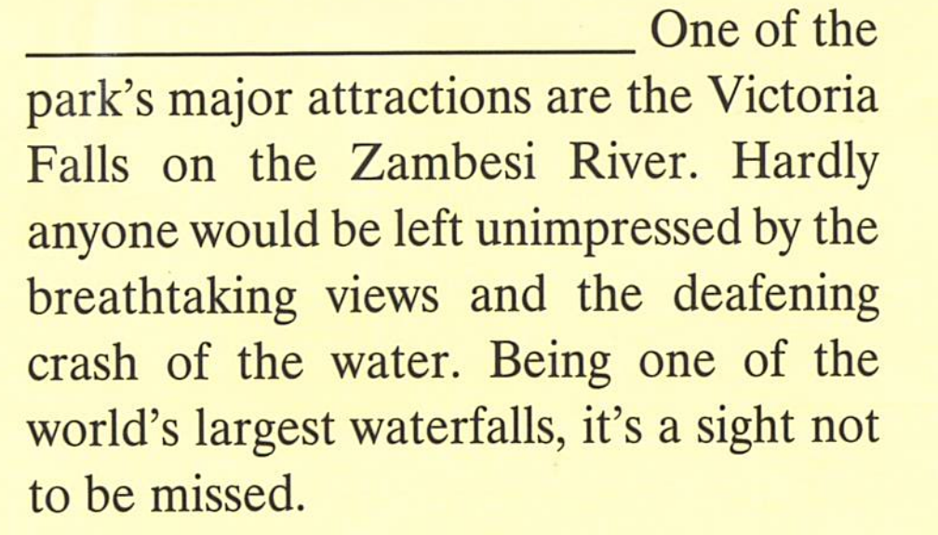

Slide 8
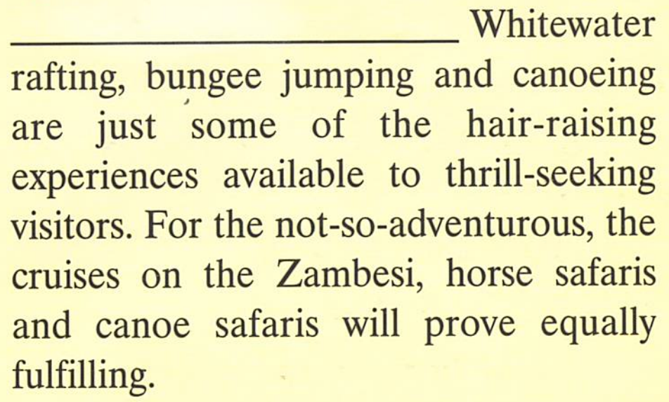

Slide 9
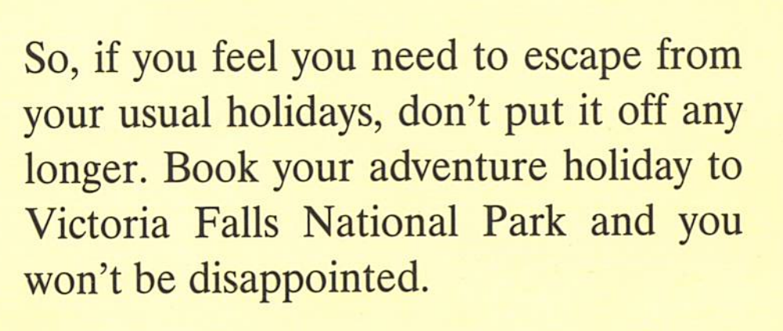

Slide 10
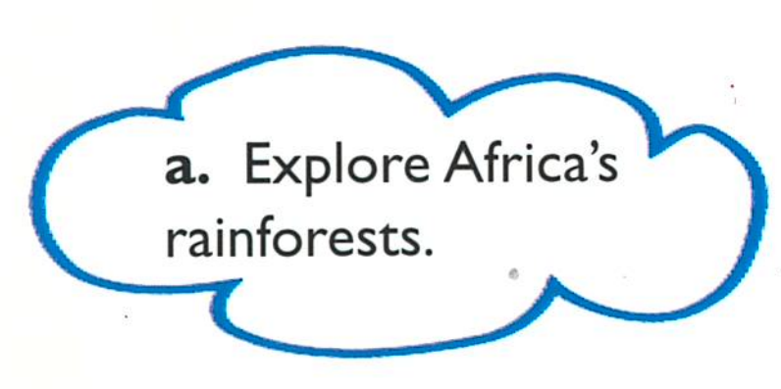

Slide 11
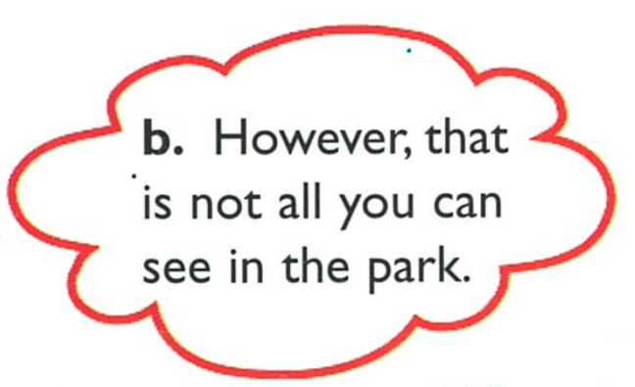

Slide 12
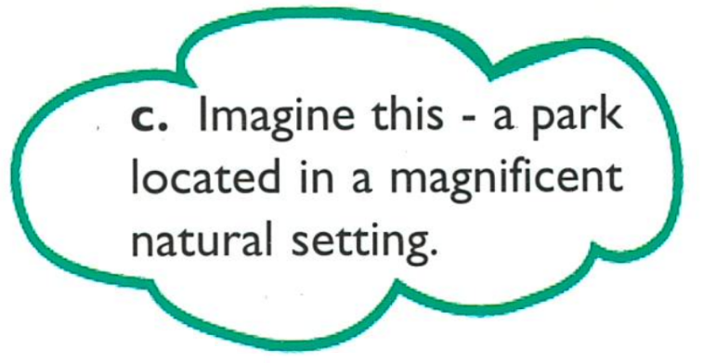

Slide 13
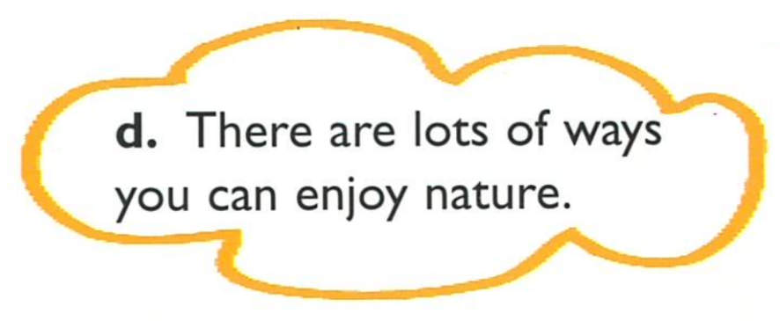

Slide 14
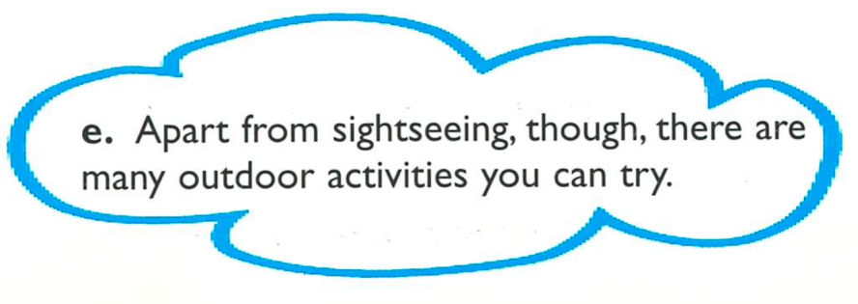

Slide 15
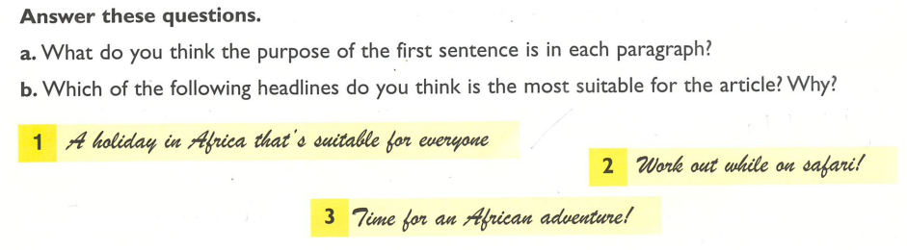
To indicate what the rest of the paragraph is about.
is not suitable because the text did not mention families. It’s also a bit boring.
2) only describes the more energetic activities described in paragraph 4. Paragraph 2 and 3 are about sightseeing, and there is certainly nothing remotely energetic about taking a stroll, which means a slow leisurely walk.
3) is the most suitable because it
grabs the reader’s attention and
best describes the text.
Click on a. for the answer to a.
Click on the numbers for the answers to b.

Slide 16
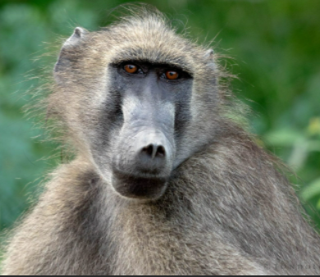
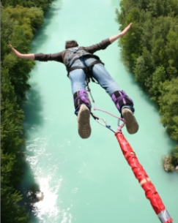
Glossary
sightseeing seeing the sights the interesting things and places that can be seen. E.g. Big Ben, Tower Bridge, Buckingham Palace. You can’t go inside. You look from outside.
stroll a slow leisurely walk.
safari an expedition to observe or hunt animals in their natural habitat.
excursion a short journey or trip for pleasure, especially one a short distance away from the main place you are visiting.
baboon
Bungee jumping

Slide 17
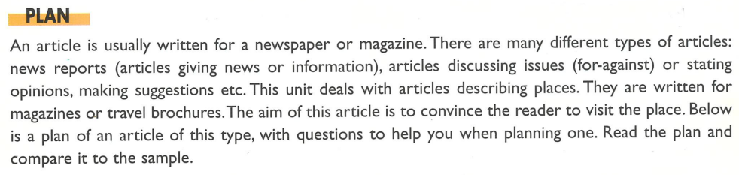

Slide 18
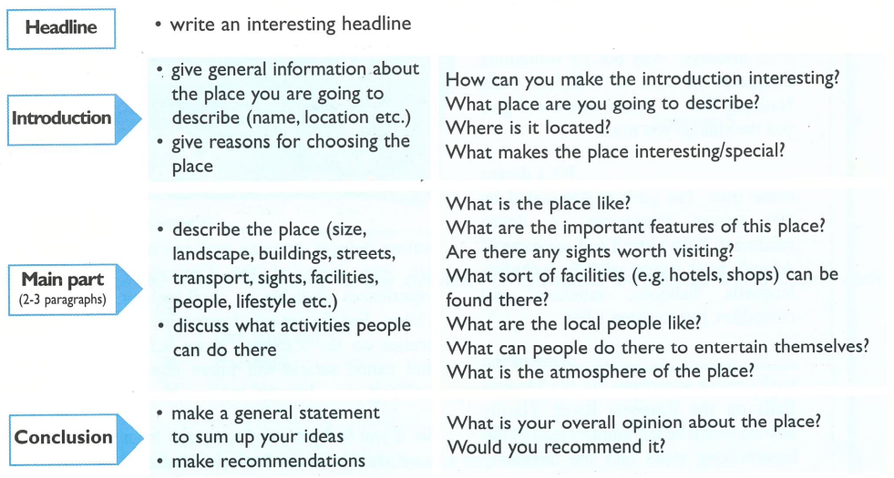
Actually, this is only a guide to planning. Your plan will answer these questions.

Slide 19
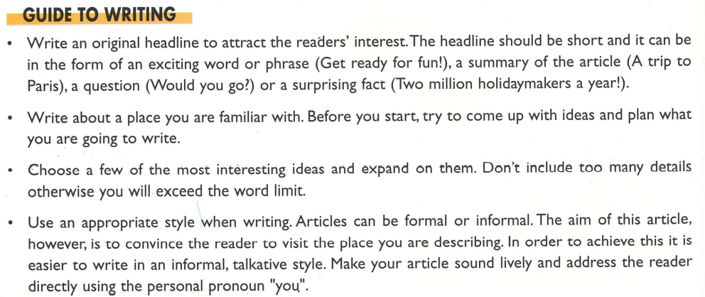

Slide 20
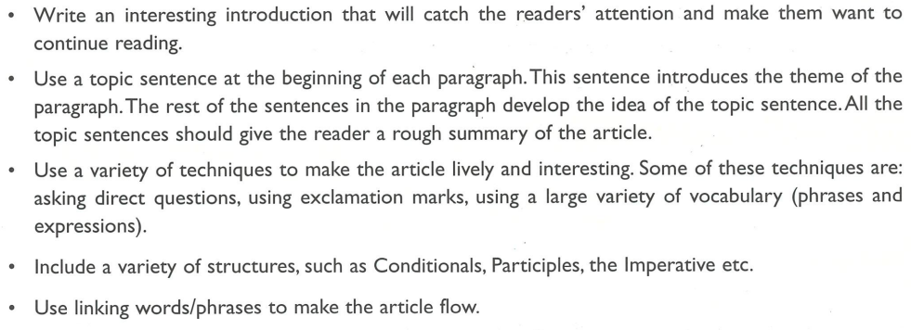

Slide 21
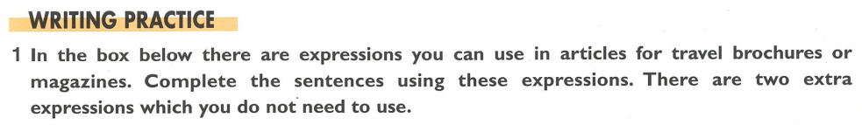


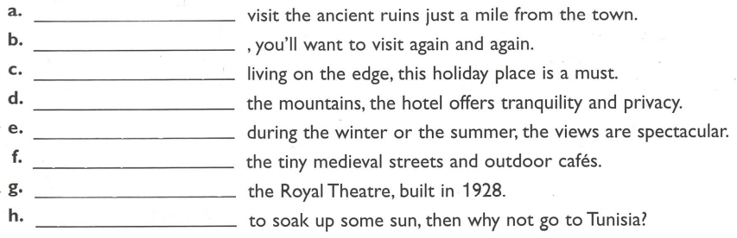
Make time to
Once discovered
For those who enjoy
Set in
Whether you go
By day explore
Something worth visiting is
If you just want

Slide 22
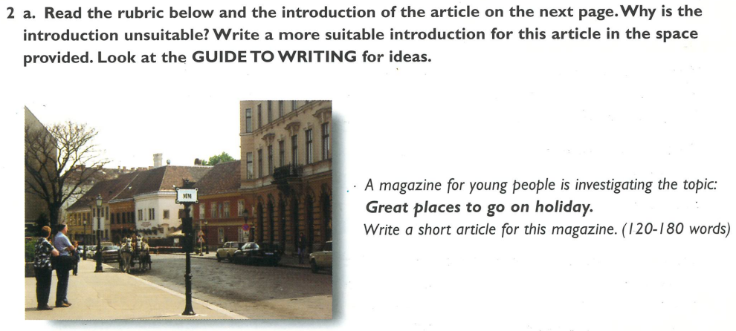

Slide 23
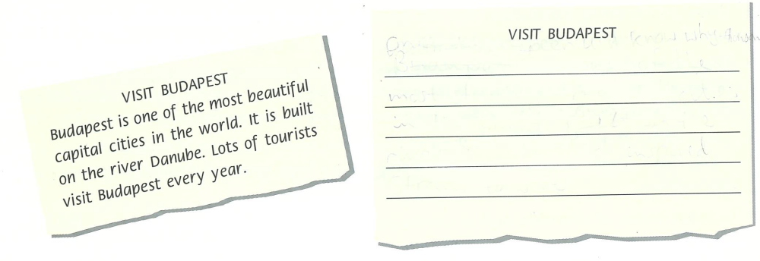
What can you discover in Budapest?
Is Budapest one of the best cities in Europe? I think so! It's one of the most charming cities in the world. Built on the Danube, Budapest is one of the most beautiful and famous cities for tourists in the world.

Slide 24
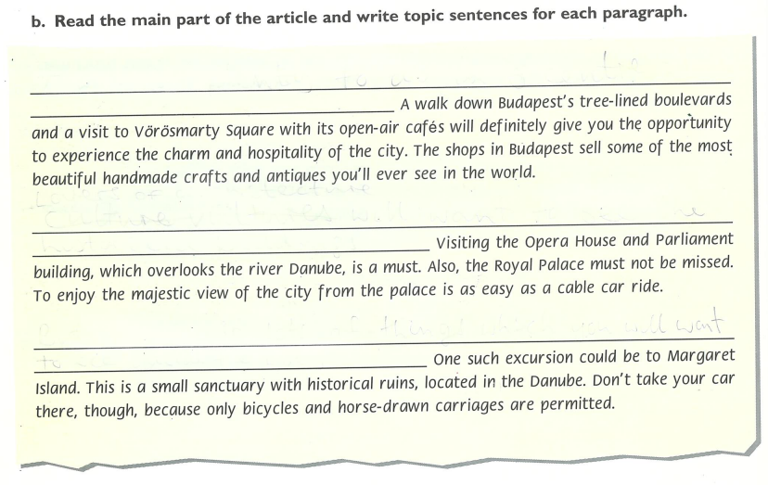
Make time to visit the old town.
A little further from the old town, you’ll find some of Budapest’s most famous sights.
But don’t just stick to the main sights; Budapest also offers some enjoyable excursions a bit further out.

Slide 25
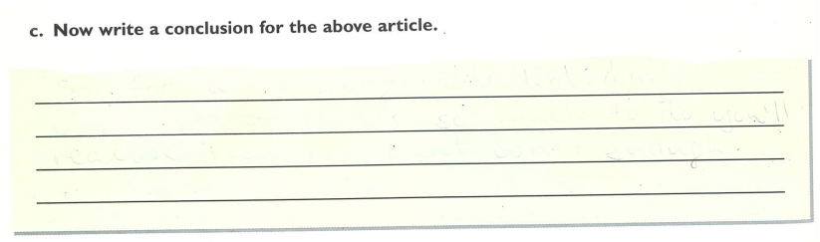
It’s truly remarkable what this city has to offer for all
kinds of travellers. I've had many good memories of Budapest and hope to have many more, so go and visit. You won’t be disappointed.

Slide 26
3 Task for homework A local English language newspaper is going to publish articles about places worth visiting in your country. Write an article to be published in this newspaper.
(120-180 words)
Your country may refer to the UK or your country of origin depending on your preference. If you want the extra practice, you could of course do one of each.

